Slide 1
Digital Forensics

Slide 2
"What one man can invent; another can discover."
Sherlock Holmes

Slide 3
What is Forensics?
Use of scientific or technological technique to conduct an investigation or establish facts (evidence) in a criminal case.
– Judd Robbins, Computer Forensic Legal Standards and Equipment

Slide 4
Digital Forensics
Digital Forensics is defined as the process of collecting, preserving, analyzing, interpreting, and documenting digital evidence and then presenting the outcomes.
Used to be called “Computer Forensics”

Slide 5
Digital Investigation focuses on digital devices
Computer
PC, Laptop, Server
Router, Switch
Phones
SIM Card
ATM Machines
Game Systems
PDA
Digital Cameras
Thumb Drive (aka USB)
Backup Media
– CD, DVD, Tapes
Printers

Slide 6
Preparing a Digital Investigation
Role of digital forensics professional is to gather evidence to prove that a suspect committed a crime or violated a company policy
Collect evidence that can be offered in court or at a corporate inquiry
Investigate the suspect’s computer
Preserve the evidence on a different computer
Follow an accepted procedure to prepare a case

Slide 7
Overview of a Digital Crime
Digital media can contain information that helps law enforcement determine:
Chain of events leading to a crime
Evidence that can lead to a conviction
Law enforcement officers should follow proper procedure when acquiring the evidence
Digital evidence can be easily altered by an overeager investigator

Slide 8

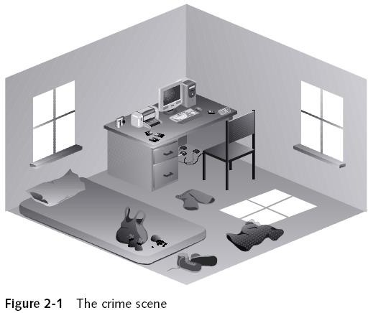
Examining a digital crime

Slide 9
Chain of custody
Route the evidence takes from the time you find it until the case is closed or goes to court
Due to the fact digital evidence can theoretically be altered, attorneys have argued that digital evidence is inherently less reliable than other forms of evidence. Therefore, chain of custody must be maintained to preserve the integrity of digital evidence as it passes through the stages of investigation. For example, cryptographic hash functions are widely used to ensure digital evidence integrity. It is crucial to preserve digital crime scene during a digital investigation.

Slide 10
Chain of custody (continued)
chain of custody involves documenting who had control of the evidence, and what was done to the evidence during what period of time. Also, the evidence should be appropriately physically protected.
Two types:
1. Single-evidence form
- Lists each piece of evidence on a separate page
2. Multi-evidence form
- Lists multiple evidences on a same page

Slide 11

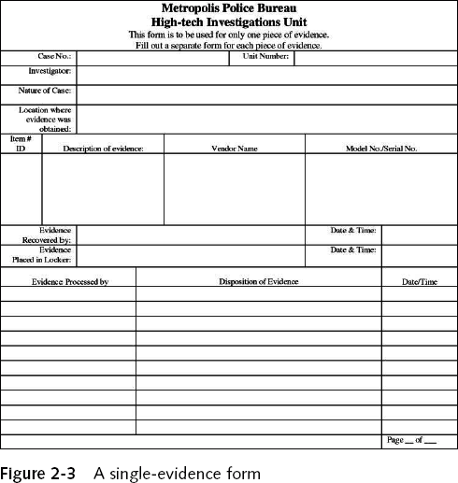

Single-evidence form

Slide 12
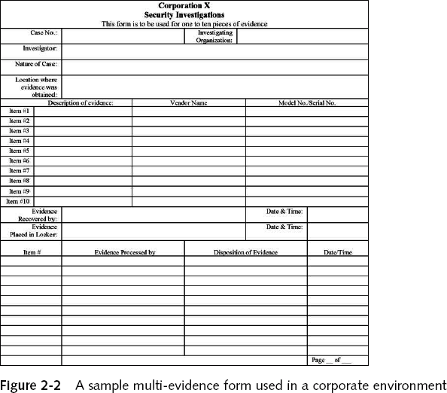
Multi-evidence form

Slide 13
Types of computer forensics

Slide 14
Types of computer forensics
File system forensics
Memory forensics
Operating System forensics
Network forensics
Malware forensics
Mobile Device forensics

Slide 15
File system forensics
Data on a physical medium, such as a hard drive or flash drive, is organized, labeled, and governed by a file system; FAT, NTFS, and EXT are the most commonly used file systems, but there are many more, and it is also possible that a suspect could have created their own file system, in order to complicate an investigation. File System Forensics is generally used for discovering the locations of files that are more useful as evidence than the file system itself; however, the presence of a custom file system, as well as the presence of anomalies in the locations of data (namely, data existing where it shouldn’t), are usually proof of immoral activities. Though not directly punishable, the presence of immoral activities is a very strong indicator of illegal activities, which warrants further investigation.

Slide 16
Memory forensics
Despite being called RAM forensics, this term actually refers to the application of forensic techniques on any/all volatile memory, which includes RAM, caches (of all levels), and registers (not to be confused with registries). Memory forensics must be performed during live analysis, because the contents of volatile memory are permanently lost when the system is shut down

Slide 17
Operating System Forensics
Logfile analysis is a major part of operating system forensics, because logfile formats differ wildly between operating systems. The Linux equivalent to the Windows registry for example is not a hierarchical GUI like the registry, but a series of organized text files instead. To perform operating system forensics, the investigator must have deep and thorough knowledge of multiple operating systems, as well as the ability to understand the meaning of logs generated by different operating systems.

Slide 18
Network Forensics
IP Tracing and Network Traffic Monitoring are the major components of Network Forensics. The main objective is to look for evidence of illegal activities that involve a transfer of files or information. It is important to note that while most applications of Network Forensics make use of the Internet, LANs, local ad-hoc networks, and emulated network connections between virtual machines (VMs) and their host machines, can all be analyzed with the same techniques.

Slide 19
Malware Forensics
Malware Forensics mostly refers to the reverse engineering of malware, but also covers the detection of existing or possible malware.

Slide 20
Mobile Device Forensics
Some mobile devices use proprietary operating systems, such as iOS, Windows Mobile/CE, and BlackBerry OS, while others are built on opensource systems, such as Android; an investigator would need to know all of them to be effective in the field. There are also many different types of mobile devices: smart phones, PDAs, and digital cameras and all of them use different operating systems and have different capabilities, storing different types of data. A mobile phone might contain taped conversations, digital pictures, texts and emails, contact lists, and sometimes even digital video recordings. It is worth noting that the manufacture and model also play a role in the methods used, further complicating the investigation. Even analyzing two devices that are very comparable in the consumer market could, and usually does, result in using very different combinations of techniques to retrieve the information required.

Slide 21
Procedures for conducting digital Forensics investigation

Slide 22
Methodological models
There exist many methodological (procedures) models which have been developed in the field of digital forensics.
Examples of methodological models:
KRUSE and HEISER model
Yale University model
Rodney McKemmish model

Slide 23
Rodney McKemmish model
Identification
Preservation
Presentation
Analysis

Slide 24
Identification
The identification of digital evidence is the first step in the forensic process. Knowing what evidence is present, where it is stored and how it is stored is vital to determining which processes are to be employed to facilitate its recovery.
In addition, the computer forensic examiner must be able to identify the type of information stored in a device and the format in which it is stored so that the appropriate technology can be used to extract it.

Slide 25
Preservation
The preservation of digital evidence is a critical element in the forensic process. Given the likelihood of judicial scrutiny in a court of law, it is imperative that any examination of the electronically stored data be carried out in the least intrusive manner.
There are circumstances where changes to data are unavoidable, but it is important that the least amount of change occurs. In situations where change is inevitable it is essential that the nature of, and reason for, the change can be explained. Alteration to data that is of evidentiary value must be accounted for and justified.
This applies not only to changes made to the data itself, but also includes physical changes that are made to the particular electronic device to facilitate access to the data.

Slide 26
Analysis
The analysis of digital evidence—the extraction, processing and interpretation of digital data—is generally regarded as the main element of forensic computing. Once extracted, digital evidence usually requires processing before it can be read by people. For example, when the contents of a hard disk drive are imaged, the data contained within the image still requires processing so that it is extracted in a humanly meaningful manner. The processing of the extracted product may occur as a separate step, or it may be integrated with extraction.

Slide 27
Presentation
The presentation of digital evidence involves the actual presentation in a court of law. This includes the manner of presentation, the expertise and qualifications of the presenter and the credibility of the processes employed to produce the evidence being tendered.

Slide 28
References
https://link.springer.com/book/10.1007/978-3-030-00581-8
Dr. Ali Hadi ashemery slides

